Slide 1


HEP Weekly Report
George Bakas
NTUA

Slide 2
Progress Report
DCS
dbEditorAndNavigator in fwInstallationUtils component
Bug fixes
New features
fwInstallUtils ConfDbChecks
System checks for all types of ddresses
With some help, now its faster
Redundancy task
Created a redundant project
FSM Link node to other redu project
Several switches from active to passive-> Node was responding without problems

Slide 3
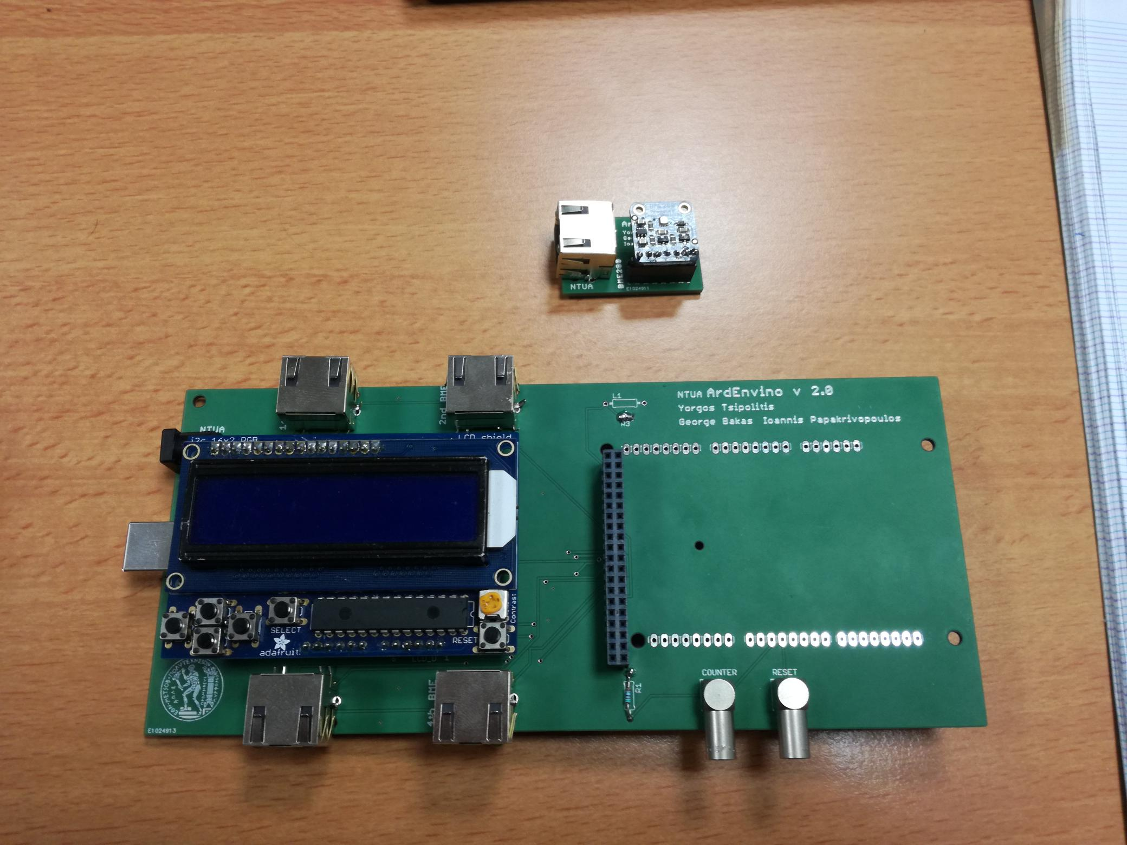
ArdEnvino
New boards are here
Most of parts needed are here
Managed to read from 3 sensors at the same time
Created a script that will run during the test beam

Slide 4
Analysis
Produced root files for particle and parton extrapolation for all MC variations and Nominal MC variations
partonEfficiencies→ need for 2 extrapolations: 1 to common phase space and then to parton phase space
Closure Test
Closure test is the unfolding and extrapolation procedure in each level compared with the MC true distribution (parton or particle)
Closure tests were successful for particle and parton (all variables ptJJ, mJJ, etaTop, ptTop and yJJ)
PLC’s
Met with Machi, Piero is not yet at CERN
Started creating several Objects using their component and trying to understand what does every object do
Machi will put sensors on a rack that they have so that the sensors that we communicate with have valid values

